Slide 1

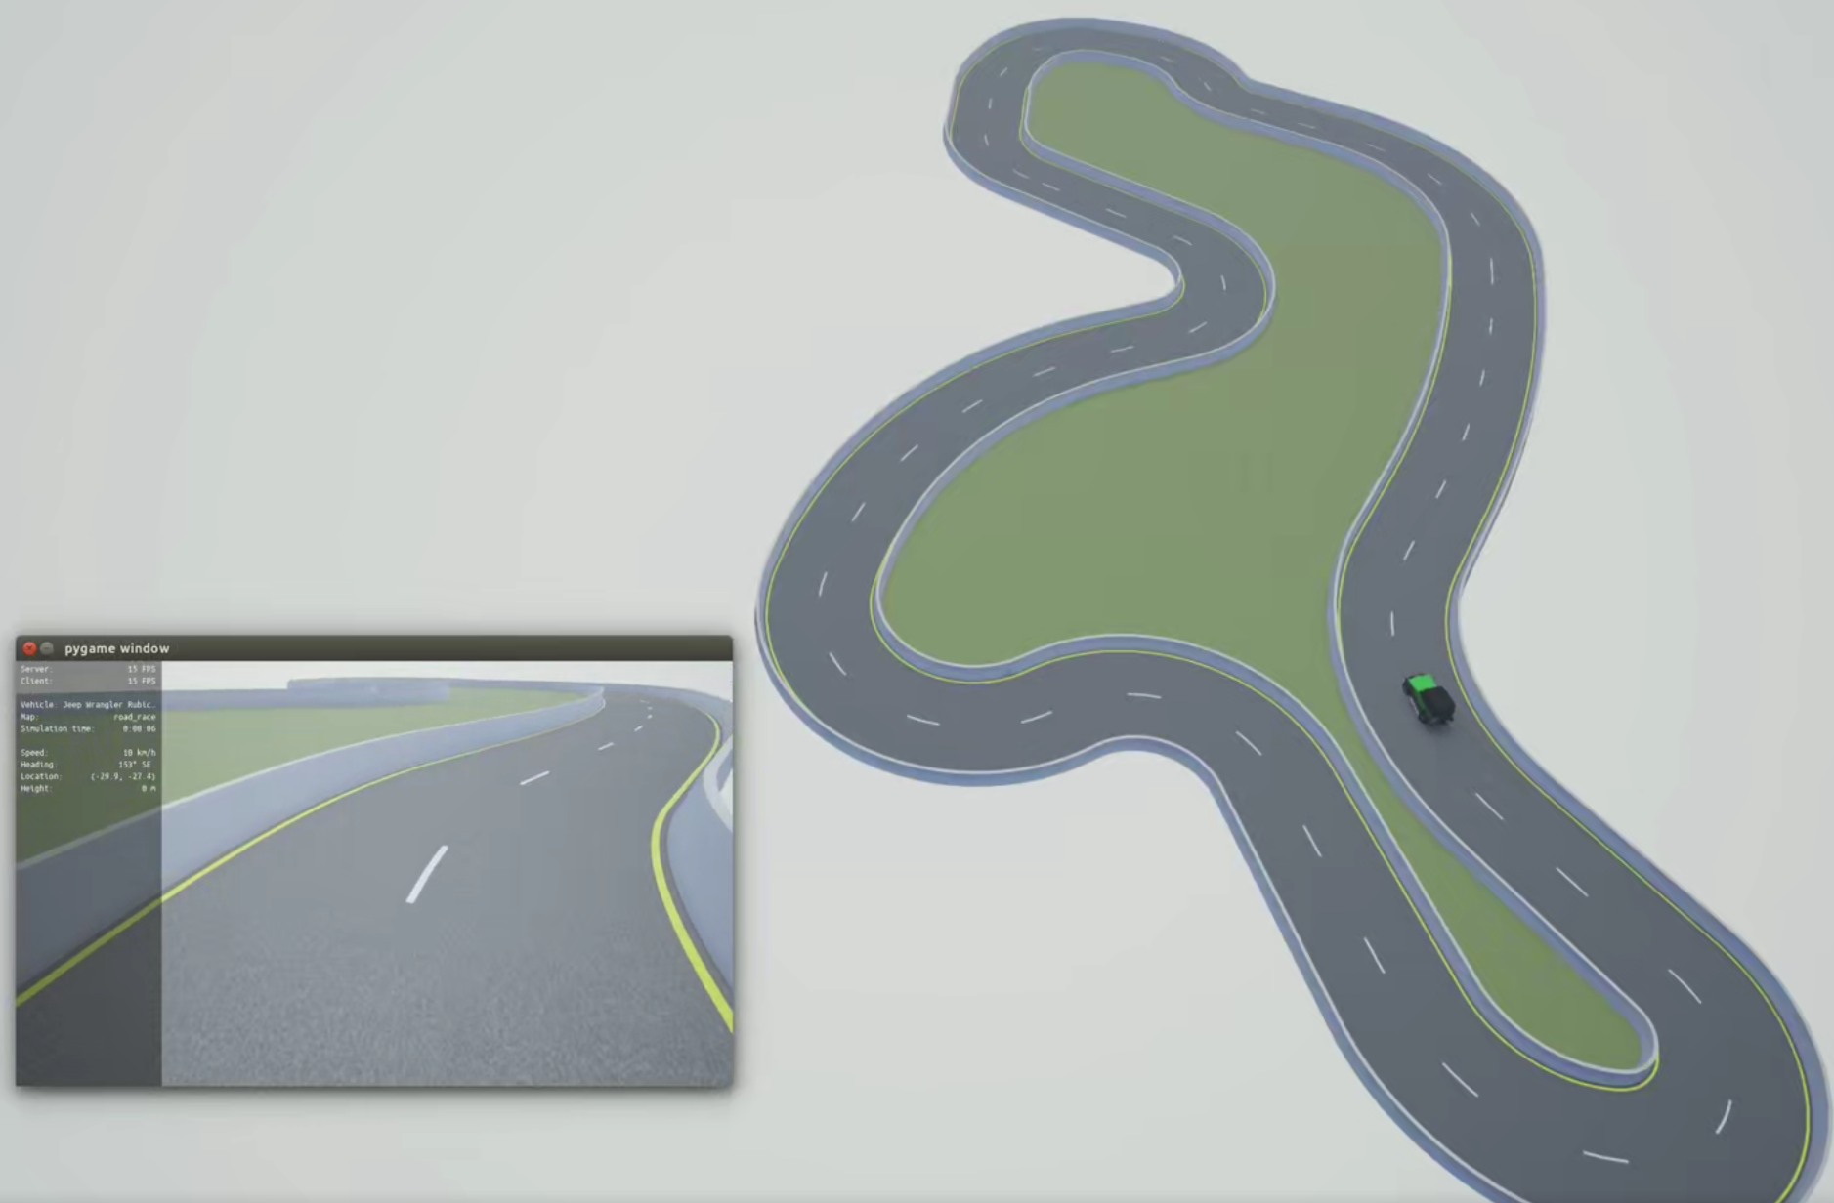
MoCAD: Carla-python Experimental Course
Environment setup and Spawning a vehicle

Slide 2
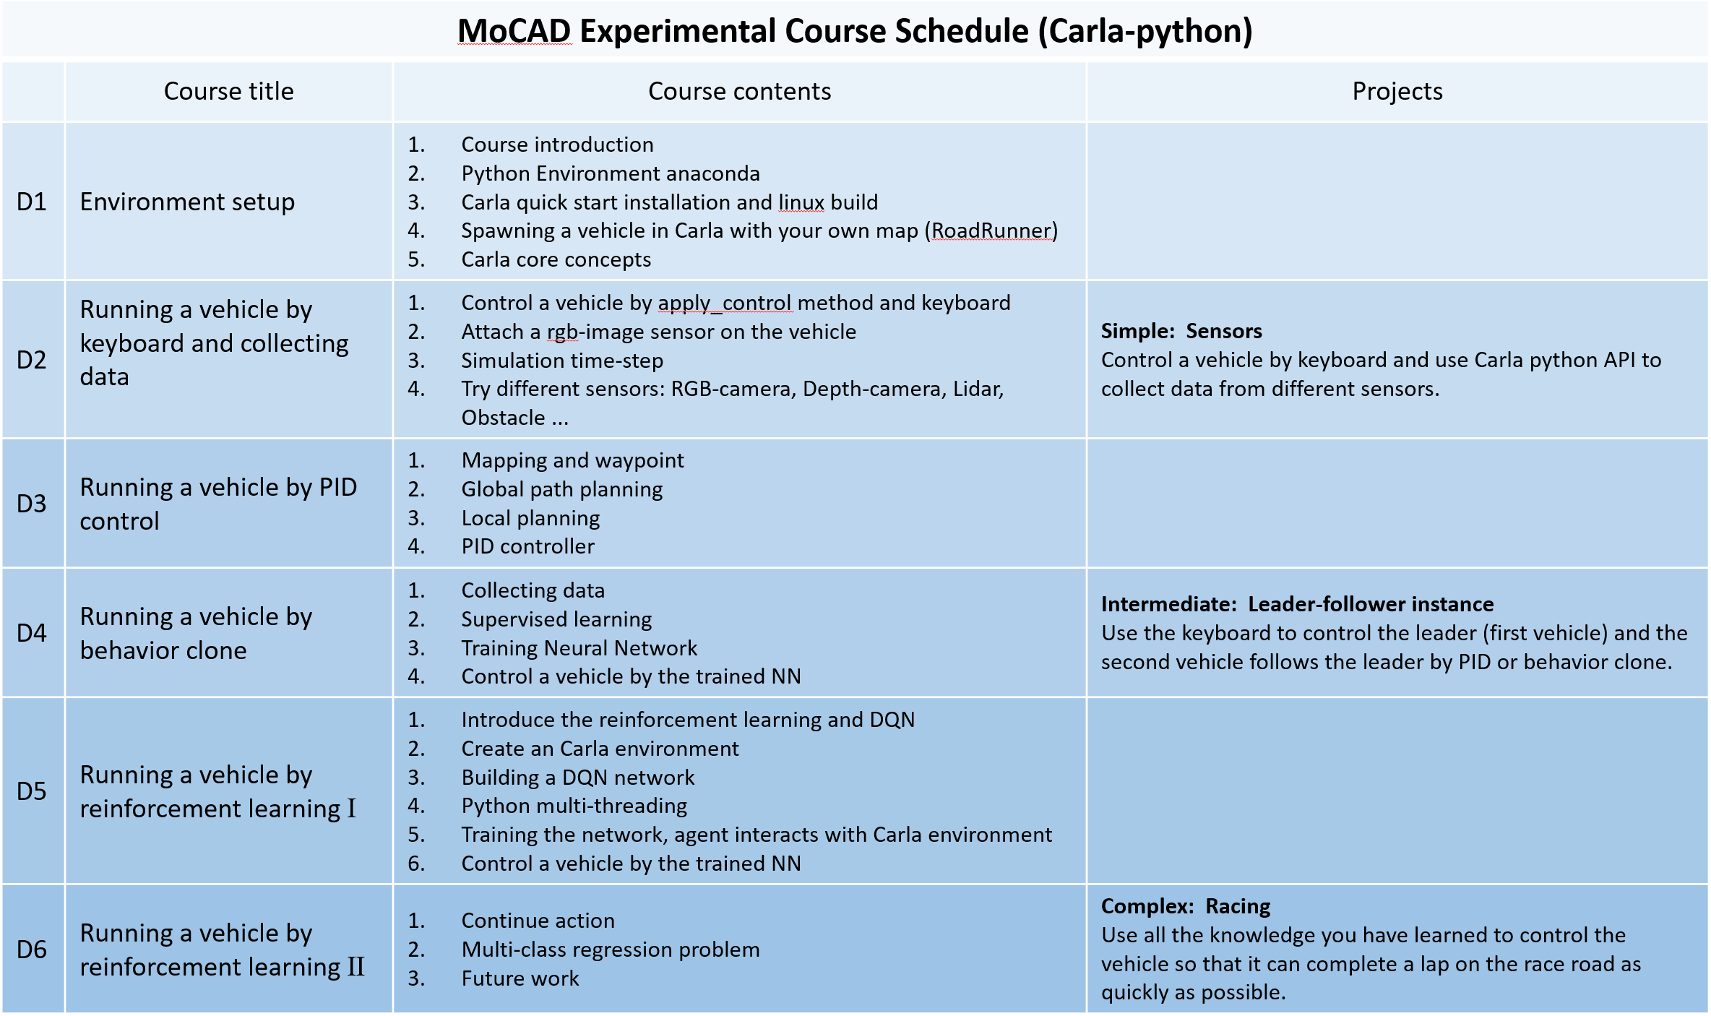
CARLA courses roadmap

Slide 3
Course contents
Introduce Carla
Carla installation
Carla Linux build
Add your own map with Roadrunner
CARLA Core concepts
Spawning a vehicle in Carla

Slide 4
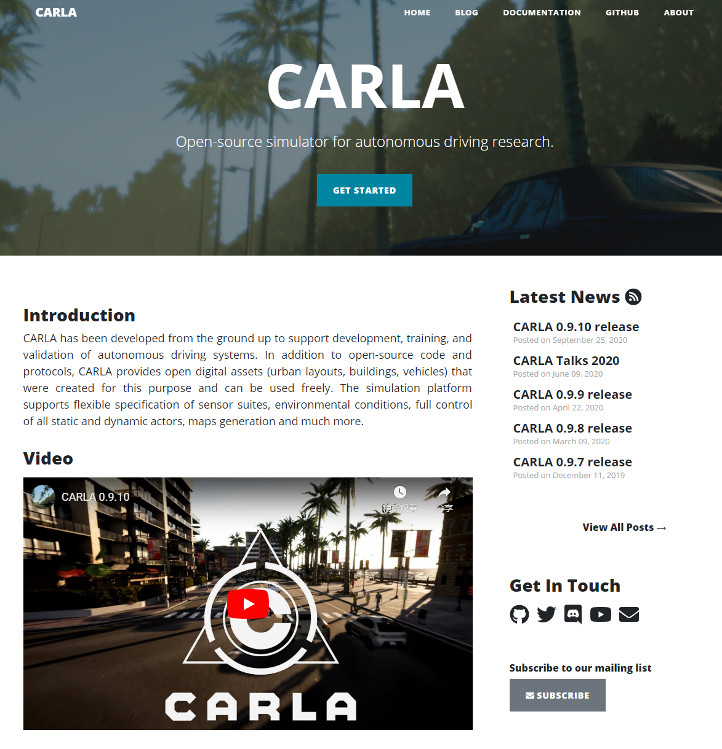
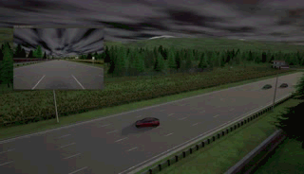
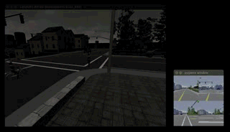


CARLA simulator
CARLA is an open-source autonomous driving simulator.
CARLA, 0.9.0 or later
What is Carla ?
Why we use Carla ?
How we use Carla ?
Unreal Engine 4.24
OpenDRIVE 1.4 (roads and urban settings)
The general problem of driving
(e.g. learning driving policies, training perception algorithms, etc.)
Notes:
官网：http://carla.org/
Doc: https://carla.readthedocs.io/en/latest/
Github: https://github.com/carla-simulator
Unreal Engine 游戏引擎
OpenDRIVE对路网结构的描述性文件，文件格式为XML，该XML文件种包含了Road、Junction、station等诸多道路路网信息。

Slide 5
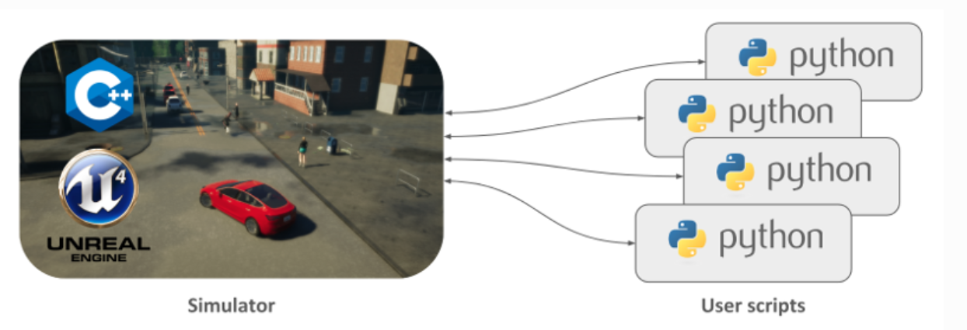
CARLA architecture: Server-Client
CARLA, 0.9.0 or later
Server (Simulator)
Client (Python API)
Update the world and actor states;
Sensors listen the data;
Simulate real world GPU；
Setting the world（scenario，weather，actor）;
Control the actors;
Notes:
仿真架构，ip和port，不同的clients。
服务器端，仿真场景，产生数据。
客户端，收集数据，控制actors。

Slide 6
CARLA installation
Quick start installation
Server side. A 4GB minimum GPU will be needed to run a highly realistic environment. A dedicated GPU is highly advised for machine learning.
Client side. Python is necessary to access the API via command line. Also, a good internet connection and two TCP ports (2000 and 2001 by default).
System requirements. Any 64-bits OS should run CARLA. However, since release 0.9.9, CARLA cannot run in 16.04 Linux systems with default compilers. These should be upgraded to work with CARLA.
Other requirements. Two Python modules: Pygame to create graphics directly with Python, and Numpy for great calculus.
A pre-packaged version of CARLA;
With Python API;
Without advanced customization, development options;
Demo:
# Linux: > ./CarlaUE4.sh
# Windows: > CarlaUE4.exe
python spawn_npc.py
Linux build
Ubuntu 18.04. CARLA provides support for previous Ubuntu versions up to 16.04. However proper compilers are needed for UE to work properly. Dependencies for Ubuntu 18.04 and previous versions are listed separatedly below. Make sure to install the ones corresponding to your system.
30GB disk space. The complete build will require quite a lot of space, especially Unreal Engine. Make sure to have around 30/50GB of free disk space.
An adequate GPU. CARLA aims for realistic simulations, so the server needs at least a 4GB GPU. A dedicated GPU is highly recommended for machine learning.
Two TCP ports and good internet connection. 2000 and 2001 by default. Be sure neither the firewall nor any other application block these.
Ubuntu 18.04 Dependencies;
Unreal Engine 4.24 only;
CARLA build;
Demo:
# Linux: > make launch
python spawn_npc.py
CPU: i7-9700
RAM: 16G
GPU: 1080 Ti
Disk: 1T ￥ 8000
Notes:
./CarlaUE4.sh
python3 spawn_npc.py # Support for Python2 was provided until 0.9.10 (not included)
Python
Anaconda
Pycharm

Slide 7




Python installation
Anaconda: python management
Pytorch & pygame
Pycharm: python IDE
conda create –n env-name python=3.7
conda activate env-name
conda install / pip install package-name
conda install pytorch torchvision cudatoolkit=10.2 -c pytorch
Pip install pygame
Import conda interpretation
Notes:
Python环境管理软件，anaconda
Package，pytorch（学习框架）和 pygame（传感器的数据显示）

Slide 8
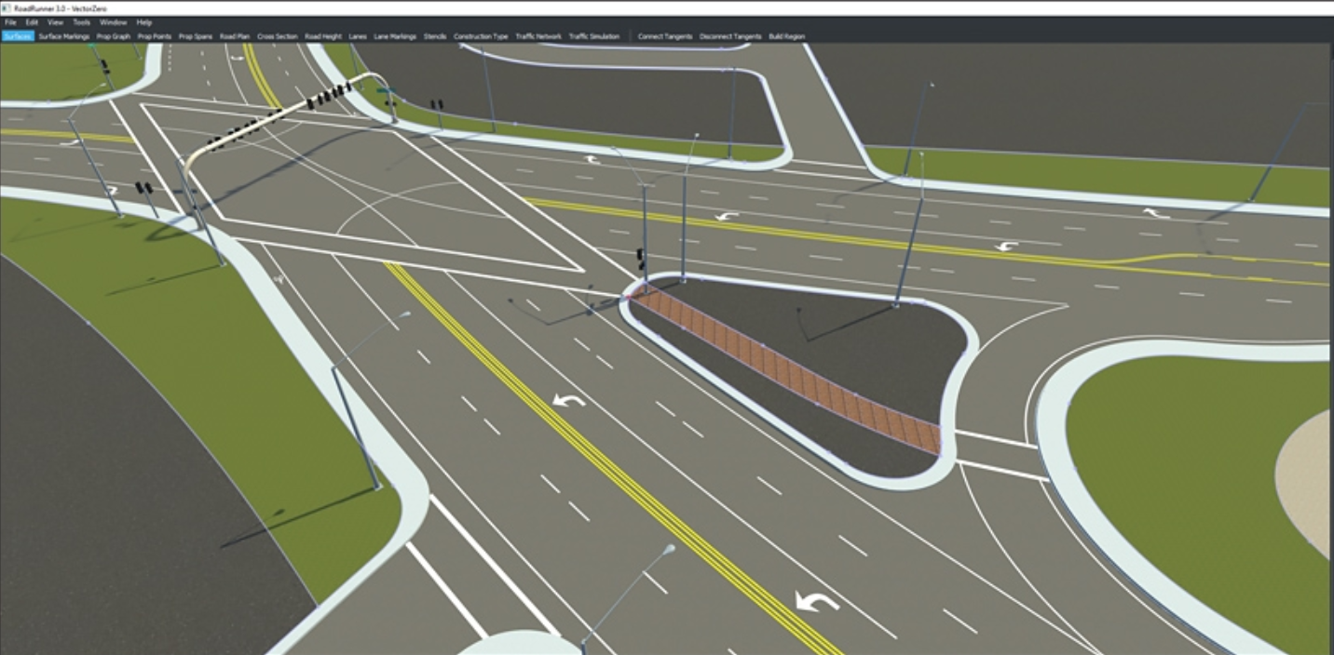

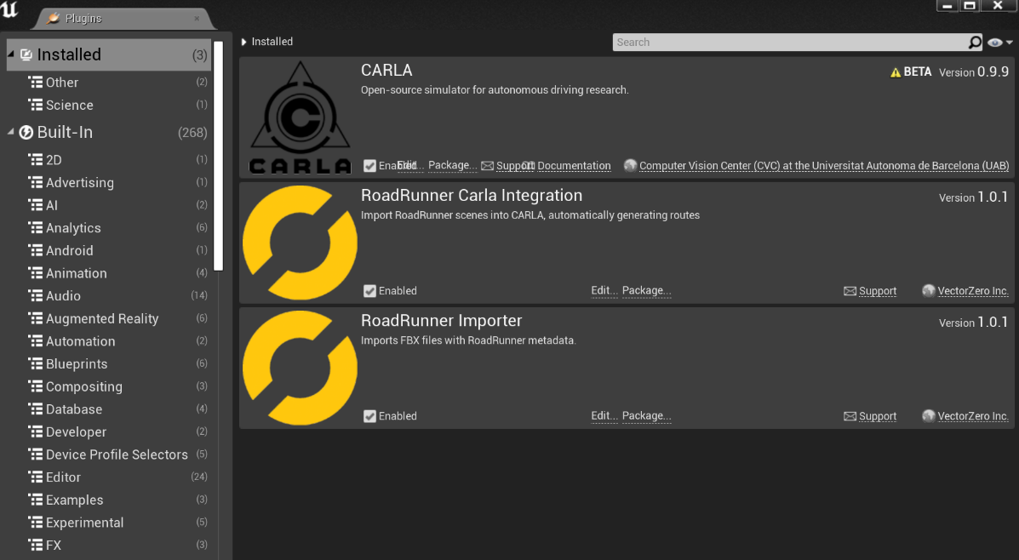
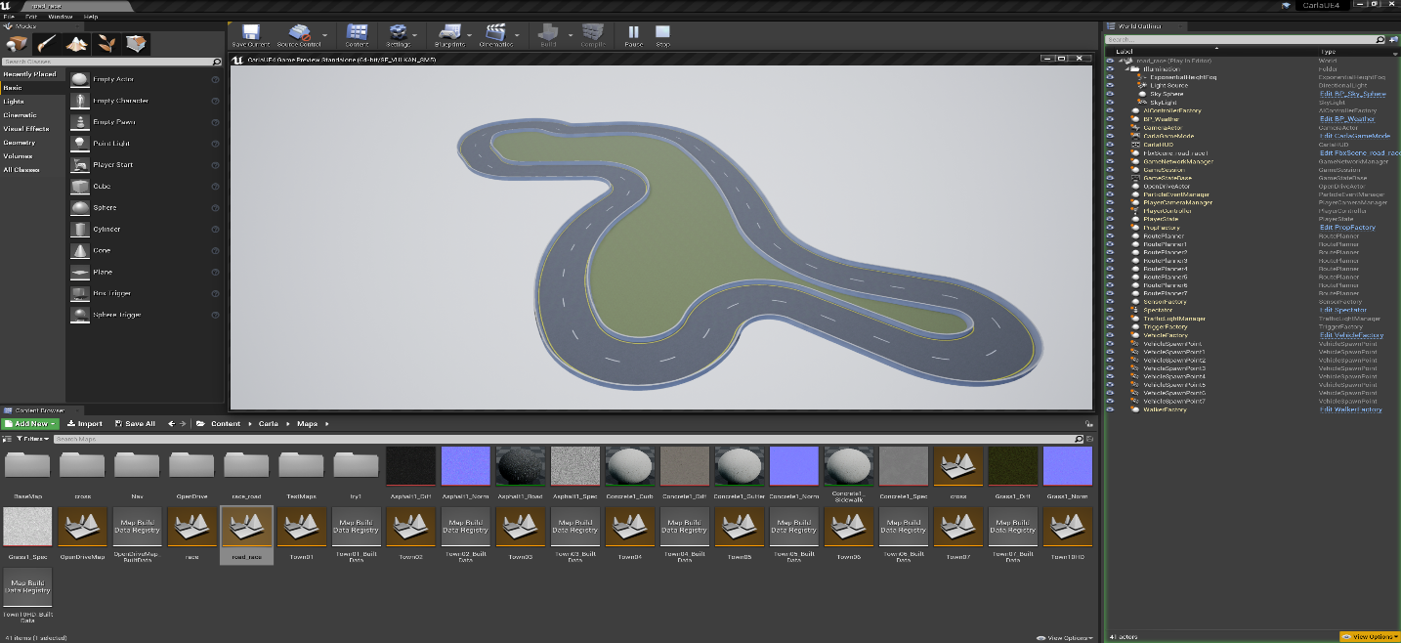
Add your own map in Unreal Engine
Create a map with RoadRunner (Matlab)
The resulting map should consist of a .fbx and a .xodr with the mesh and road network informtion respectively
Create a map with RoadRunner (.fbx and a .xodr)
Importing into CARLA/Unreal (RoadRunner plugin)
Creating Map Packages for Distribution (without building)
Notes:
https://tracetransit.atlassian.net/wiki/spaces/VS/pages/752779356/Exporting+to+CARLA
需要提供：roadrunner 插件，导入到 UE4中，使用race road地图。

Slide 9
Environment
UE4：4.24
Carla：0.9.9.4
Python：3.5
Pytorch: 1.5.0
Bug
UE4: github, running UE4 edit
Carla：python – client, anaconda python
Comment anaconda
Update about 12G
CarlaUE4 project slowly

Slide 10
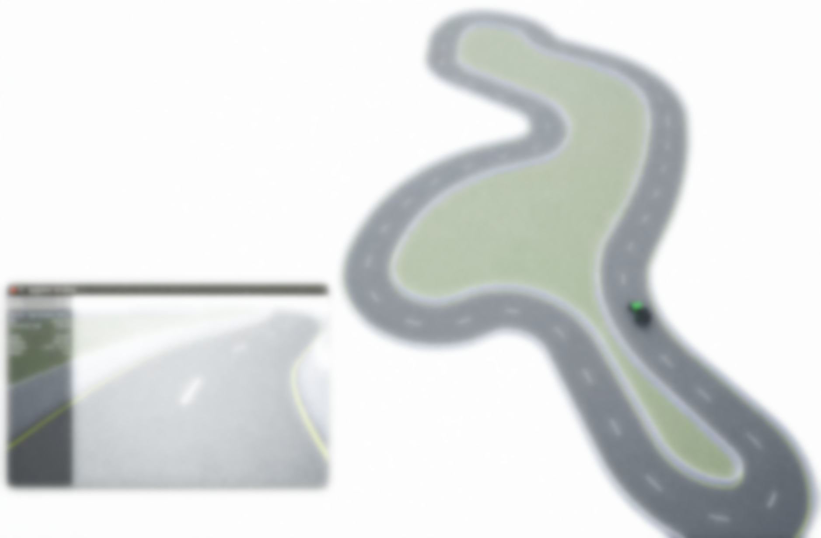
CARLA Core concepts
1st- World and client
2nd- Actors and blueprints
3rd- Maps and navigation
4th- Sensors and data

Slide 11
CARLA Core concepts
1st- World and client
Demo(carla.World ):
1. Actors
2. Weather
world.set_weather(weather)
3. Lights
4. Debugging
debug = world.debug
5. World snapshots
world_snapshot = world.get_snapshot()
6. World settings
simulation time-steps
synchrony between clients and server
Demo(carla.Client ):
1. Client creation
client = carla.Client('localhost', 2000)
client.set_timeout(10.0) # seconds
2. World connection
world = client.get_world()
world = client.load_world('Town01')
Client: an IP and a specific port；
only one world per simulation；
World: spawn actors, change the weather, get the current state of the world；
Note:
1. Client and server have different libcarla modules.
If the versions differ, issues may arise.
get_client_version() and get_server_version()
2. Changes in the weather do not affect physics. They are only visuals that can be captured by the camera sensors.
Notes:
local host IP, and port 2000
This limits all networking operations so that these don't block the client forever.
连接世界
3. Every world object has an id
4. the previous one is destroyed and Unreal Engine is not rebooted in the process
5. The parametrization includes sun orientation, cloudiness, wind, fog, and much more.
6. 画出场景中的重要信息；
7. World setting在传感器设置章节讲解。

Slide 12
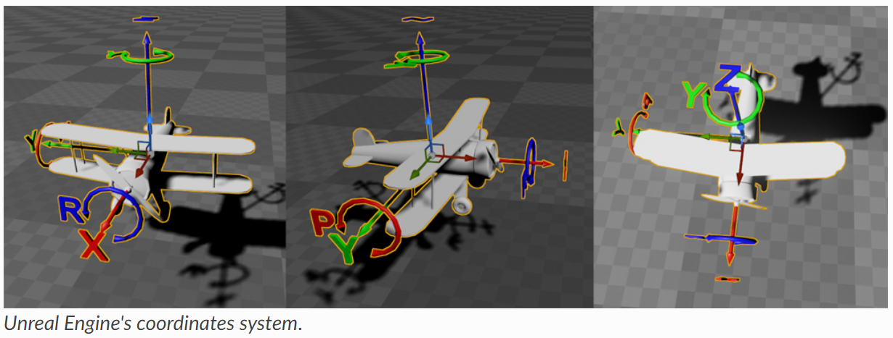
CARLA Core concepts
2nd- Actors and blueprints
Demo(carla.ActorBlueprint ):
1. Managing the blueprint library
blueprint_library = world.get_blueprint_library()
# Choose a vehicle blueprint at random.
vehicle_bp = random.choice(blueprint_library.filter('vehicle.*.*'))
vehicle_bp.set_attribute('color', '255,0,0')
2. Spawning
actor = world.spawn_actor(blueprint, transform)
An actor is anything that plays a role in the simulation；
Blueprints are already-made actor layouts necessary to spawn an actor；
Demo( carla.Transform ):
1. Stating a location and rotation for the actor
transform = Transform(Location(x=230, y=195, z=40), Rotation(yaw=180))
Demo( carla.Actor ):
1. get() and set()
actor.get_location()/ actor.get_velocity()
actor.set_location(location)
2. Destruction
destroyed_sucessfully = actor.destroy() # Returns True if successful
Note:
1. Some of the attributes cannot be modified. Check it out in the blueprint library.
2. CARLA uses the Unreal Engine coordinates system. Remember that carla.Rotation constructor is defined as (pitch, yaw, roll), that differs from Unreal Engine Editor (roll, pitch, yaw).
Notes:
Actors：Vehicles， Walkers，Sensors
Blueprints，actor生成的位置角度，相同的方法，a set of attributes，vehicle color, amount of channels in a lidar sensor, a walker's speed, and much more.
Blueprint Library（车，人，信号灯，传感器。。。）
It is crucial to have fully understanding on how to operate on them.

Slide 13
CARLA Core concepts
2nd- Actors and blueprints
Types of actors：Sensors，Spectator，Traffic signs and traffic lights，Vehicles，Walkers
Demo( carla.Vehicle ):
carla.VehicleControl
vehicle.apply_control(carla.VehicleControl(throttle=1.0, steer=-1.0))
carla.VehiclePhysicsControl
carla.VehicleLightState
vehicle.set_autopilot(True)
vehicle.bounding_box
Notes:
控制方向和速度。
物理属性

Slide 14
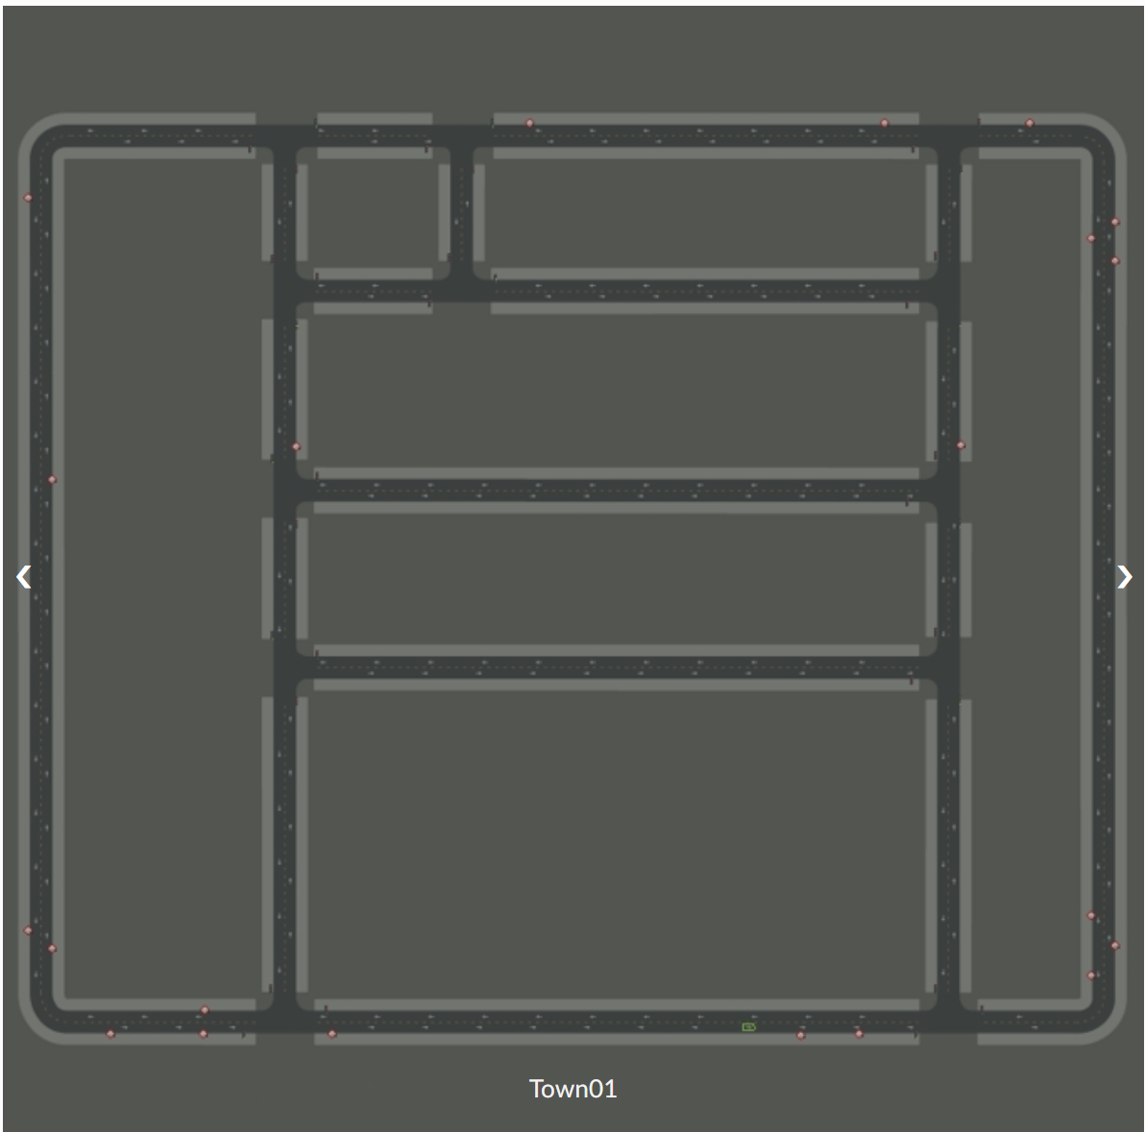
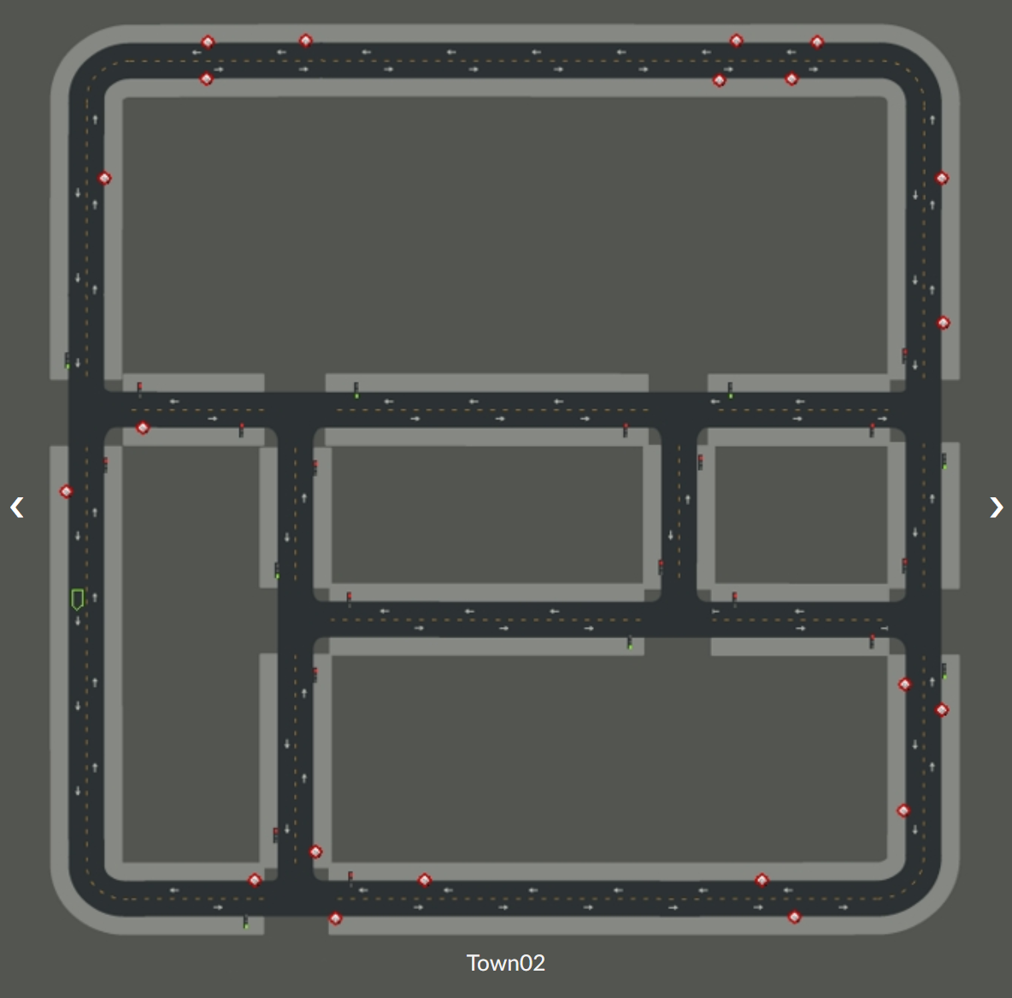
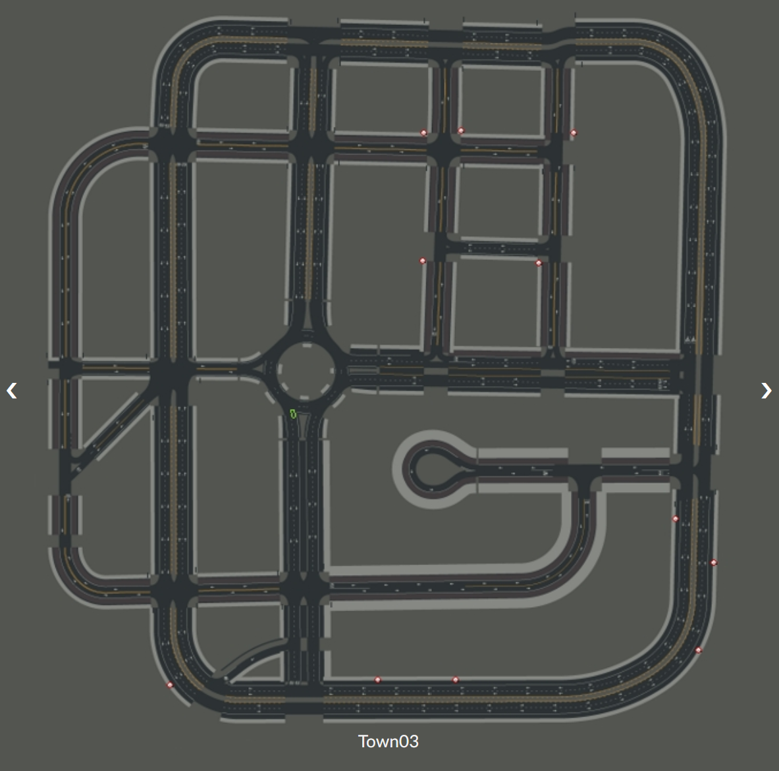
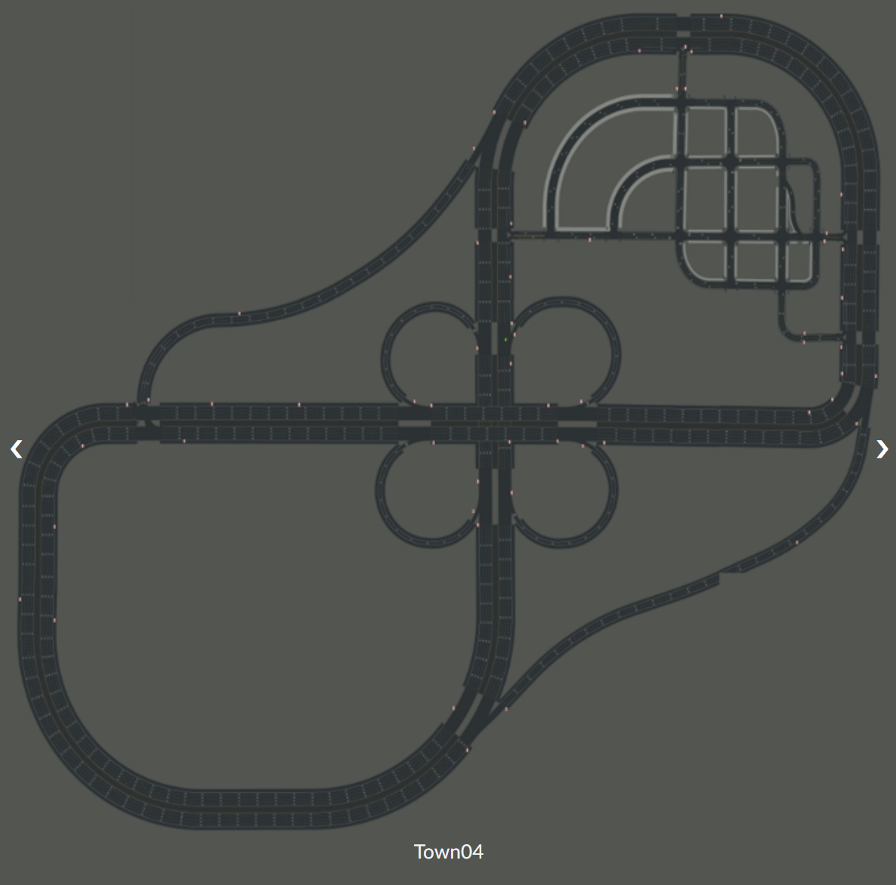
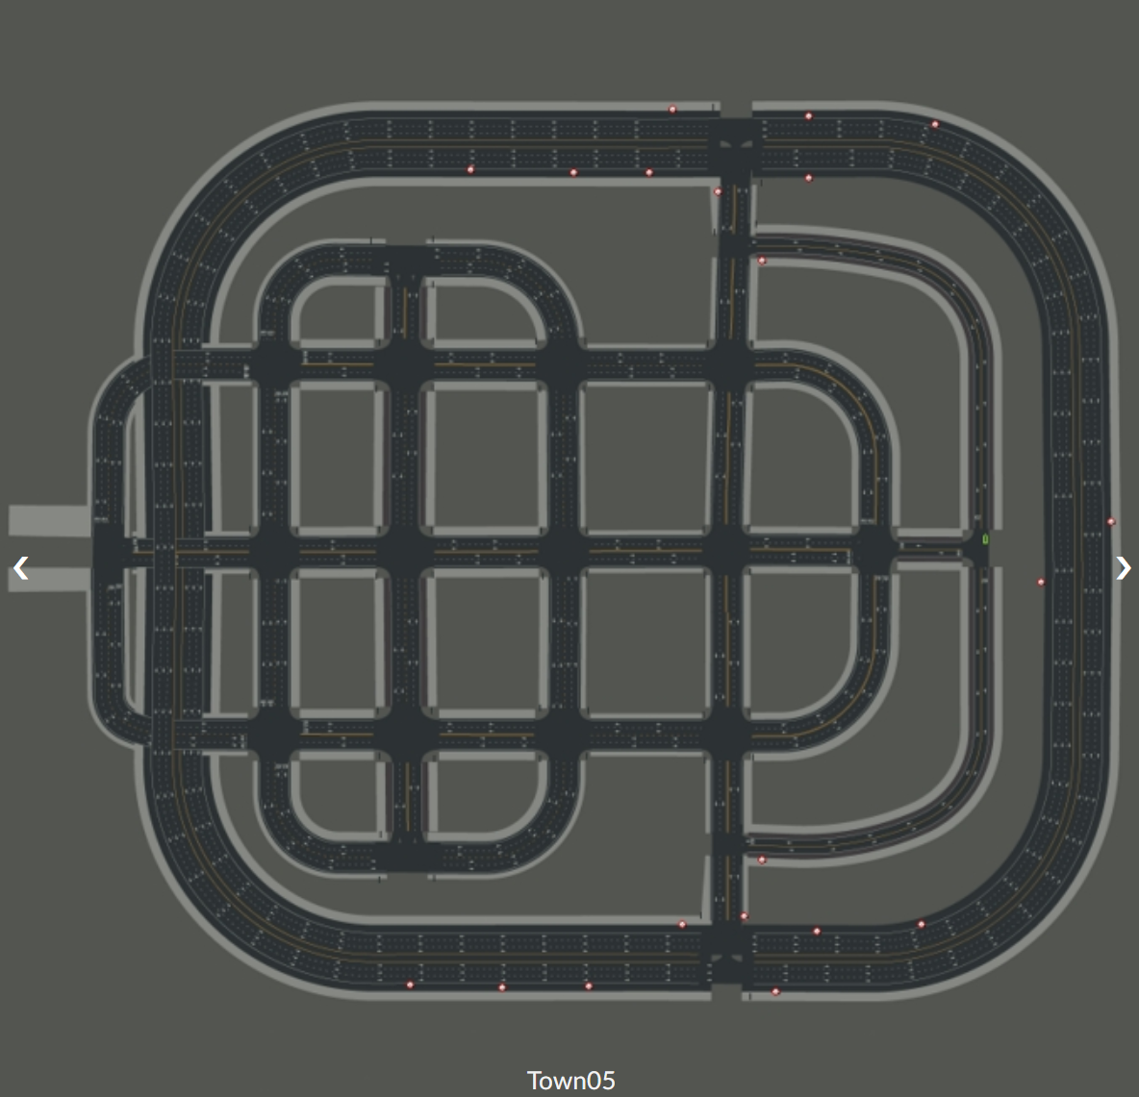
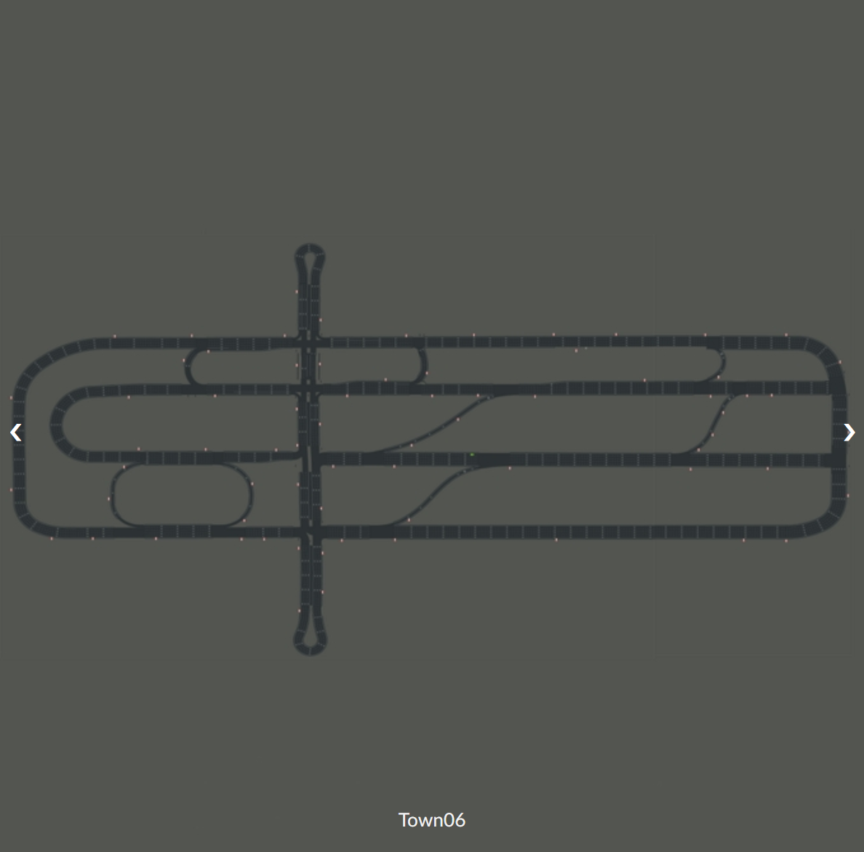
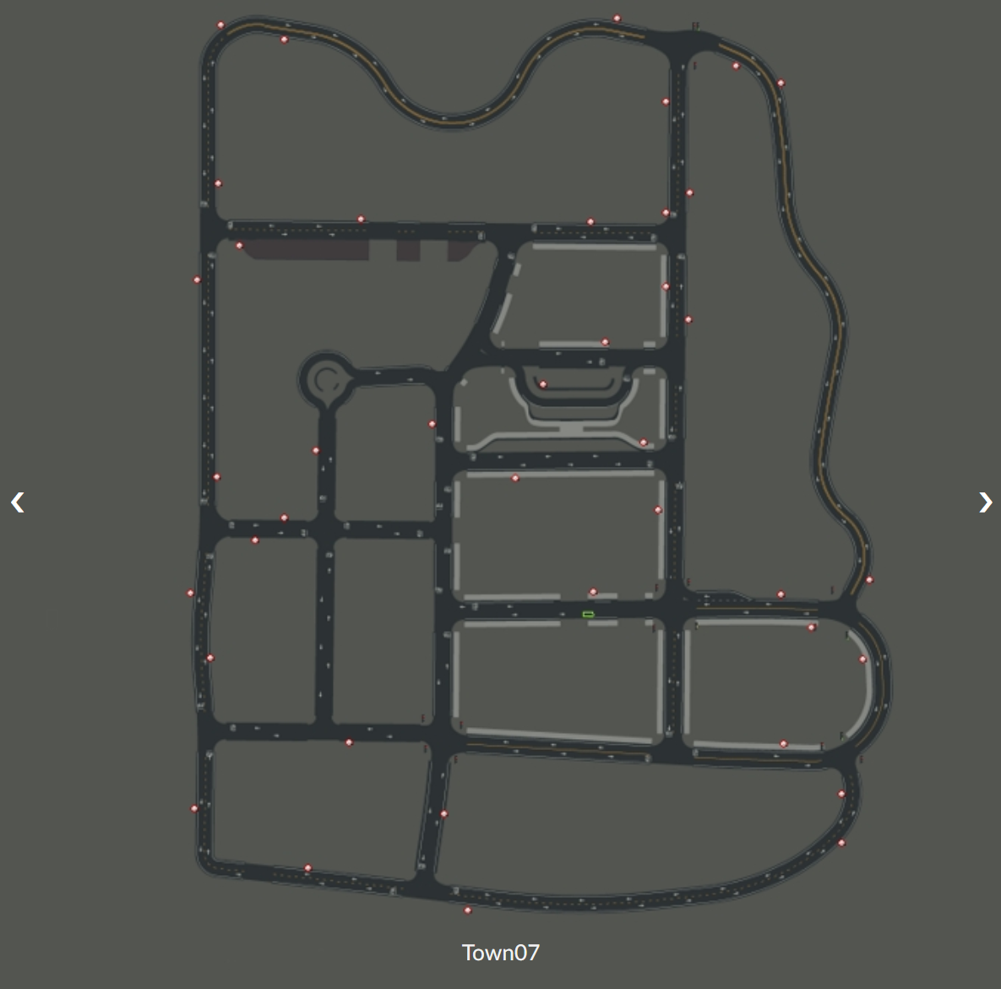
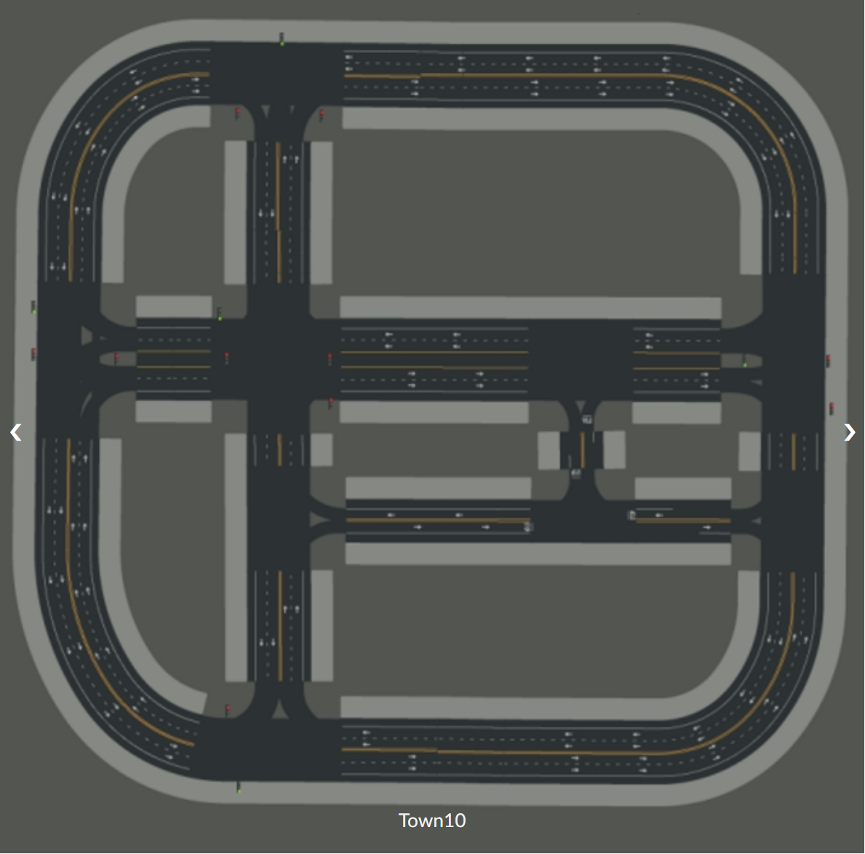
CARLA Core concepts
Demo(Carla.Client):
1. Changing the map
world = client.load_world('Town01')
3rd- Maps and navigation
A map includes both the 3D model of a town and its road definition；
The OpenDRIVE defines roads, lanes, junctions, etc. is extremely important；
Demo(Landmarks):
1. carla.Landmark
All the information defining a landmark in OpenDRIVE
2. carla.LandmarkOrientation
The orientation of a landmark in the road
3. carla.LandmarkType
A set of commonly used landmark types as defined by the default country code
4. carla.Waypoint
A carla.Transform and road information
5. carla.Map
The road information and waypoint managing
Demo(Waypoint):
a carla.Transform: location on the map and the orientation of the lane
The variables road_id,section_id,lane_id
Demo(Navigating through waypoints):
1. Waypoints create a road flow
Notes:
It determines the possibilities of the API and the reasoning behind decisions made.

Slide 15
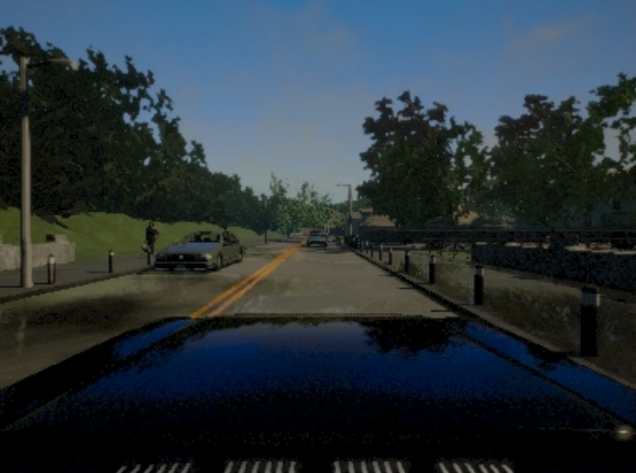
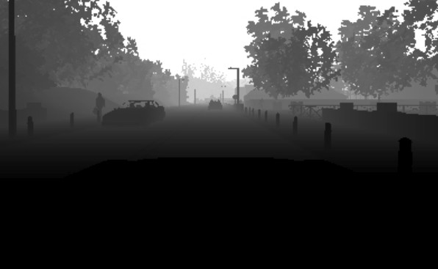
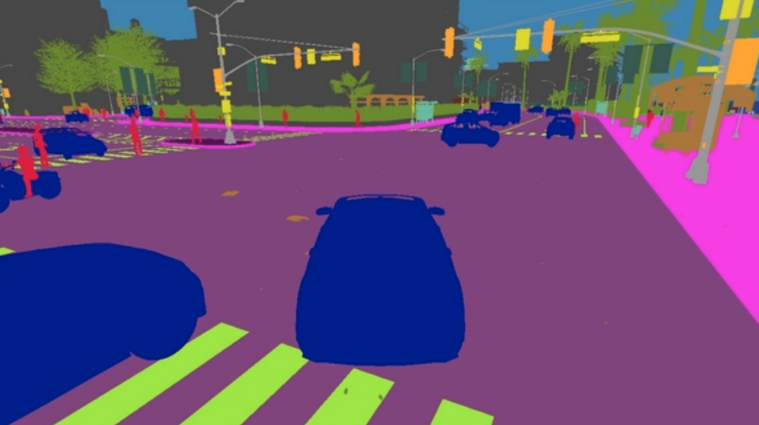
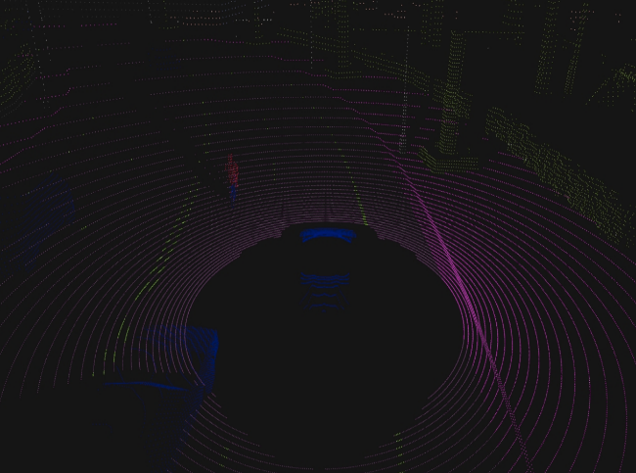
CARLA Core concepts
4th- Sensors and data
Gather data from the simulation . The waypoint class to provide vehicles with a navigation path；
Different types of sensor data；
A sensor is an actor attached to a parent vehicle；
Cameras， Collision， IMU, Obstacle … ;
Notes:
local host IP, and port 2000
This limits all networking operations so that these don't block the client forever.
连接世界
3. Every world object has an id
4. the previous one is destroyed and Unreal Engine is not rebooted in the process
5. The parametrization includes sun orientation, cloudiness, wind, fog, and much more.
6. 画出场景中的重要信息；
7. World setting在传感器设置章节讲解。

Slide 16
Reference
1. Carla Documentation
https://carla.readthedocs.io/en/latest/start_introduction/
2. Awesome CARLA
https://github.com/Amin-Tgz/awesome-CARLA
3. RoadRunner map
https://tracetransit.atlassian.net/wiki/spaces/VS/pages/752779356/Exporting+to+CARLA

